Slide 1
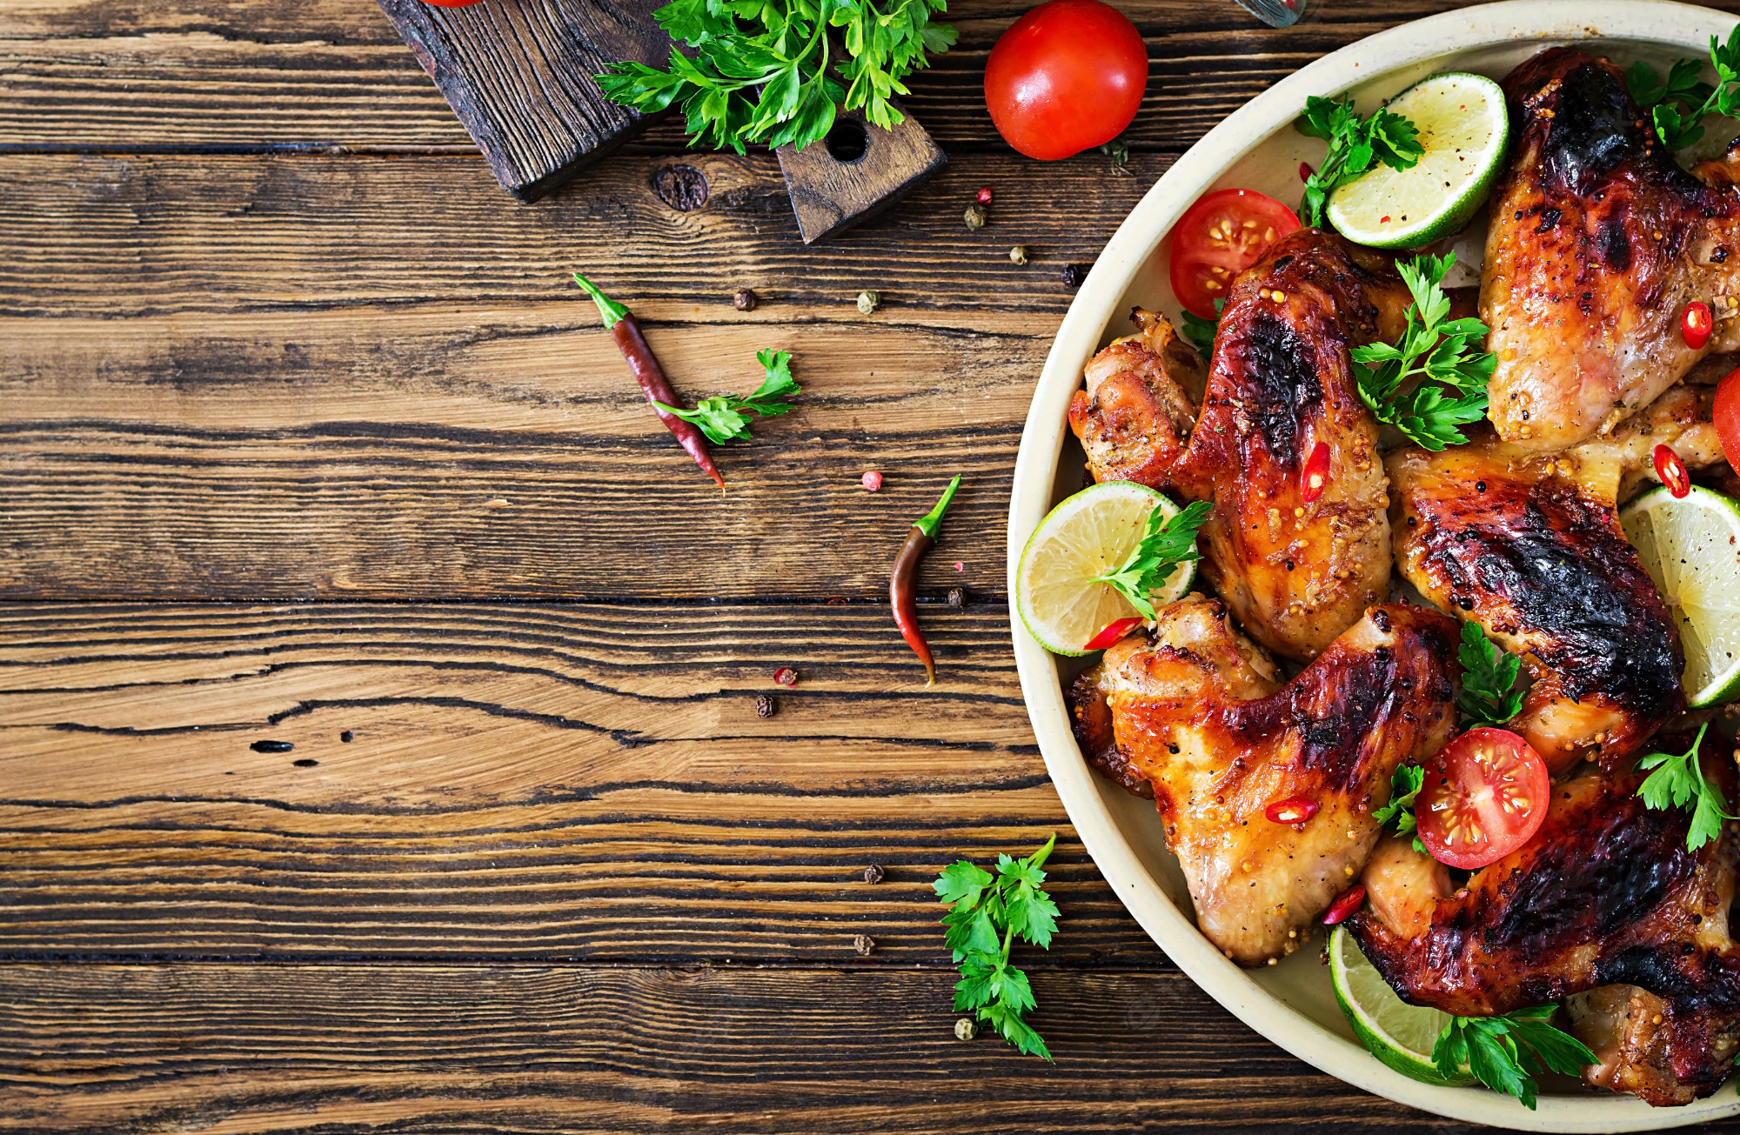

FOOD DELIVERY
01

Slide 2
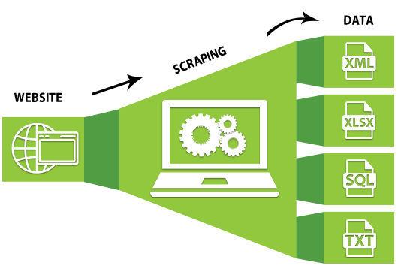
PHASES OF THIS PROJECT
Web Scrapping
CSV & Data Cleaning
Tableau Dashboard
Recommendation Model
HTML Webpage

Slide 3
WEB SCRAPPING
Selenium is a Python library and tool used for automating web browsers to do a number of tasks. One of such is web-scraping to extract useful data and information that may be otherwise unavailable.

Slide 4
Csv & Data cleaning
Cleaned the dataset using python that has been accumulated through Web-Scraping.
Conversion of raw dataset into a DataFrame.
Finally made a csv file for further analysis.

Slide 5

DASHBOARD - Tableau
For the key insights that we have received for our analysis
Used different charts to perform better visualisations
Merged with KPI’s to get a full picture of the analysis and finally made a dashboard

Slide 6
RECOMMENDATION MODEL
AIM:
Build a recommendation model for someone who wants to open a restaurant in Bangalore
Outcome:
With the help of Machine Learning we build a model that can predict the price and Location for opening a new restaurant

Slide 7
HTML WEBPAGE
1
2
Use a basic HTML coding for executing the frontend part through which the person can enter the details and based on that can get a recommended location and price for their restaurant
Used some python flask to develop a relationship between our model and the web page

Slide 8

Learned to make html page How to make ML Model Time Management Googling Team Work Tableau Dashboard

Slide 9
CHALLENGES FACED
Difficulty in website scrapping.
Python Flask was completely unknown and new to learn
HTML was also a very new thing that we faced difficulty at.
All the terms used for the project are really tough to us.

Slide 10
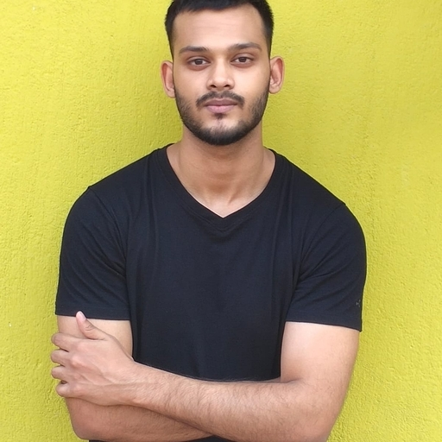

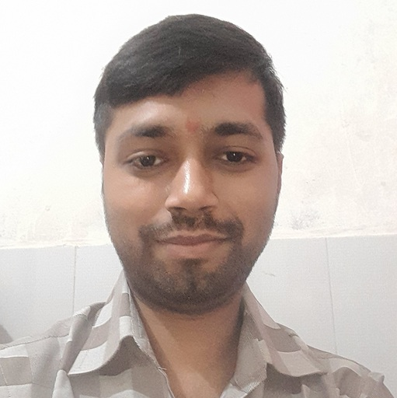
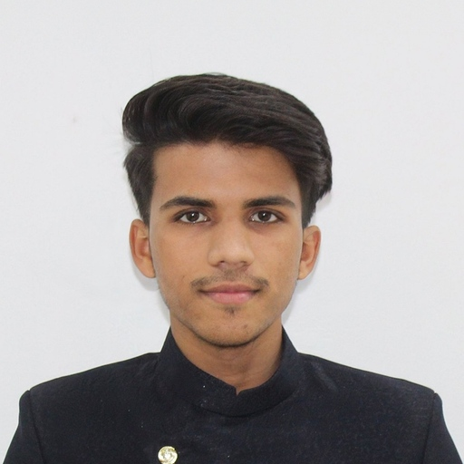

PROJECT Team Members
THE PROJECT IS THE FINAL OUTCOME OF ALL OF OURS EFFORTS.
Aditya Sarkar
Shweta Prasad
Anuarg
Rishikesh Singh
Nikhil Sharma
Pd15_128
Pd15_015
Pd15_307
Pd15_316
Pd15_162

Slide 11
Thank you!
Write a closing statement or call-to-action here.

